Slide 1

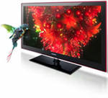
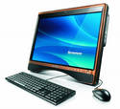
What are the modern inventions used in everyday life and make it easier?
Are inventions created in science and technologies?
Are they changing the lifestyle of millions of people all over the world?
Yes, you are right.
It’s computer technologies.

Slide 2
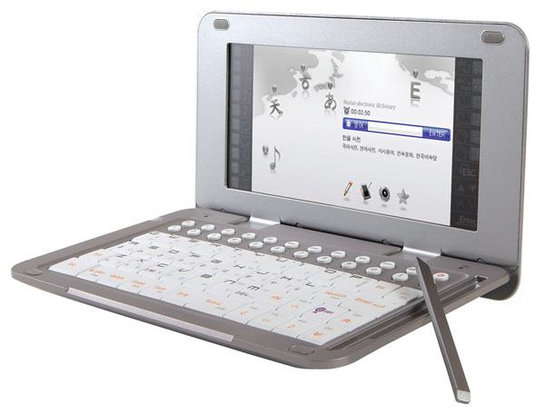
What modern inventions do people use?
And how will we work?

Slide 3

What are they used for?
But what gadget is the most popular among teenagers nowadays?

Slide 4
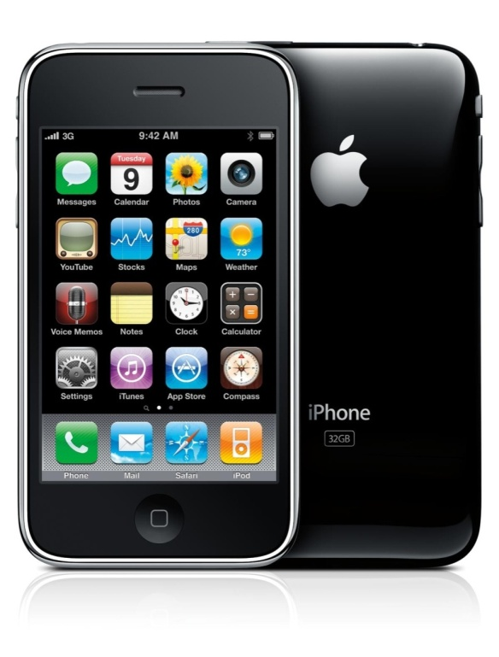

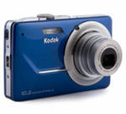

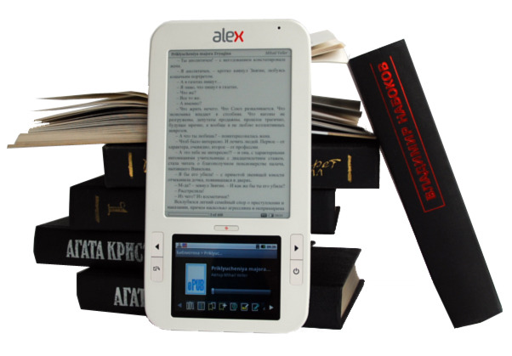
What is your favourite gadget?

Slide 5





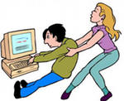
What do you think: are teenagers completely hooked on technology today?

Slide 6
Visit the website in the article on the page 69 ex.7. Ex.1 will help you. You are welcome to do it at home. So read the text and answer the questions ex. 2 and 3.

Slide 7



Draw a smile on its display (face ) if you liked the lesson or a sad expression if the lesson was useless for you.

